Slide 1
PREDICTING HOSPITAL READMISSIONS
TEAM:KINGPINS
S.SHAHEENA
G.MEGHANA
T.NANDINI
M.NISHMITHA

Slide 2
contents
Problem Statement
Objective
Introduction
Decision Tree
Working
Future Scope
Conclusion

Slide 3
PROBLEM STATEMENT
Predicting Hospital readmission for patients with diabetes using Machine Learning model.
By using Classification method which is a supervised type of learning we can predict the readmissions.

Slide 4
OBJECTIVE
The main objective of our project is to avoid the health risk and to reduce amount invested by people by predicting Hospital readmission for patients with diabetes.

Slide 5
INTRODUCTION
Machine learning is a type of artificial intelligence (AI) that provides computers with the ability to learn without being explicitly programmed.
Machine Learning
Classification
Decision Tree

Slide 6
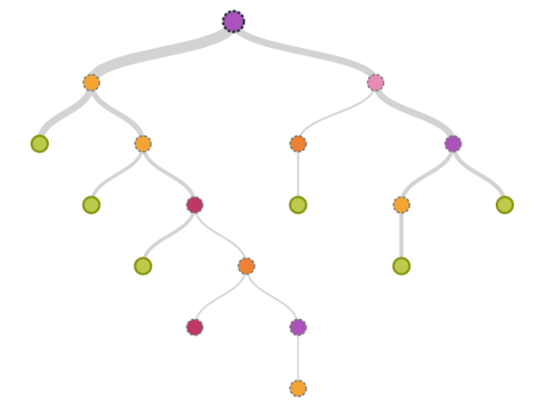
DECISION TREE MODEL
Decision tree algorithm falls under the category of supervised learning. They can be used to solve both regression and classification problems.
Decision tree uses the tree representation to solve the problem in which each leaf node corresponds to a class label and attributes are represented on the internal node of the tree.
We can represent any boolean function on discrete attributes using the decision tree.

Slide 7
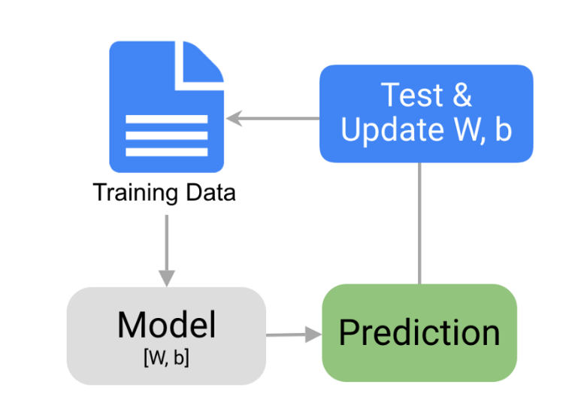
HOW MODEL WORKS
Collection of Data set
Split the values
Train and Test
Prediction
Visualization

Slide 8
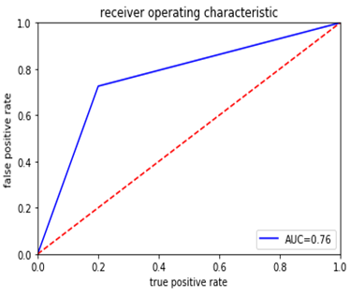
Accuracy curve

Slide 9
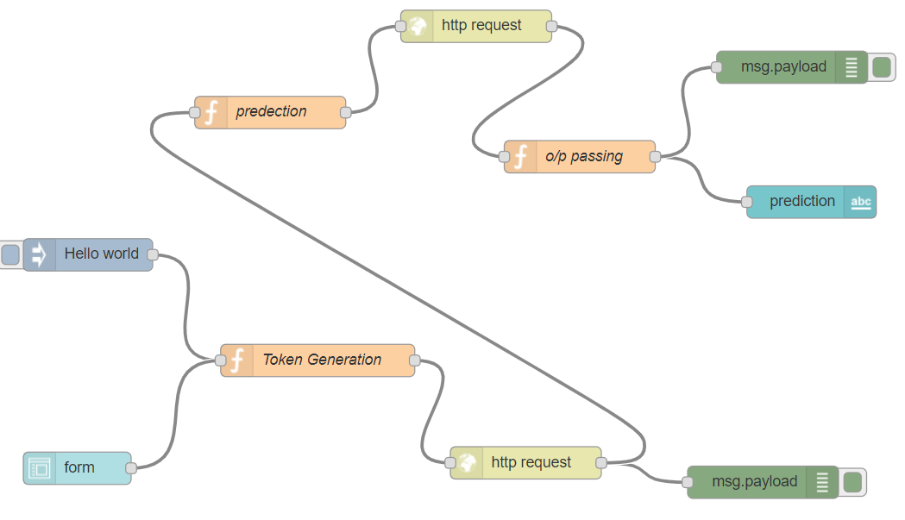

Slide 10
Future Scope
The data analyzed in this study was from a single hospital. This study can be conducted with a larger hospital sample size in rural and urban community settings in multiple states across India.
This would allow determining if the readmission factors differ based on patient geographical location or if similar traits are observed nationwide . In addition ,this would strengthen both urban and rural models while assessing the importance of age categorization.

Slide 11
conclusion
Predicting Hospital readmission rates can increase the efficiency of initial treatment at hospitals which can save a lot of lives.

